Slide 1
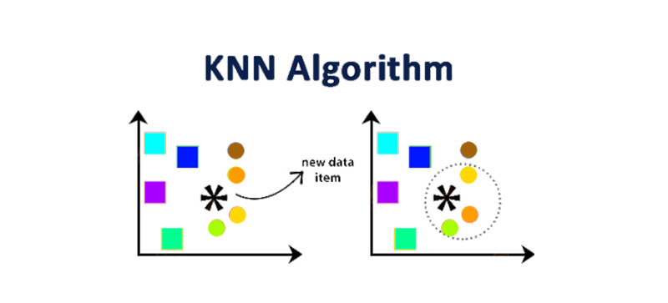

Slide 2
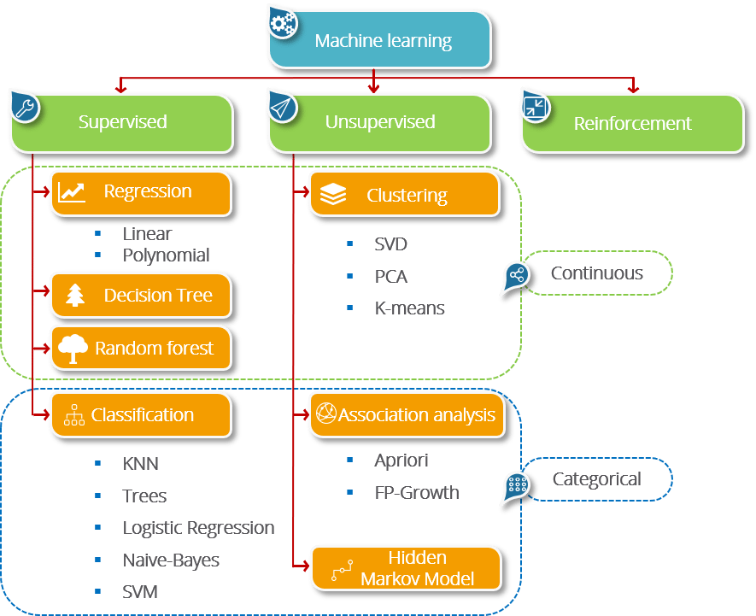

Slide 3
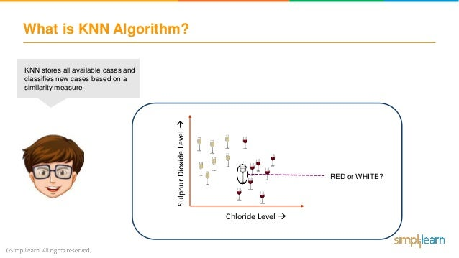
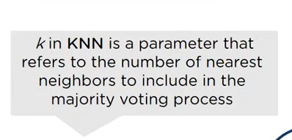
KNN stores all available cases and classifies new cases based on similarity measure
KNN-K Nearest Neighbors, is one of the simplest supervised Machine Learning algorithm mostly used for
Classification-It classifies a datapoint based on how its neighbors are classified.

Slide 4
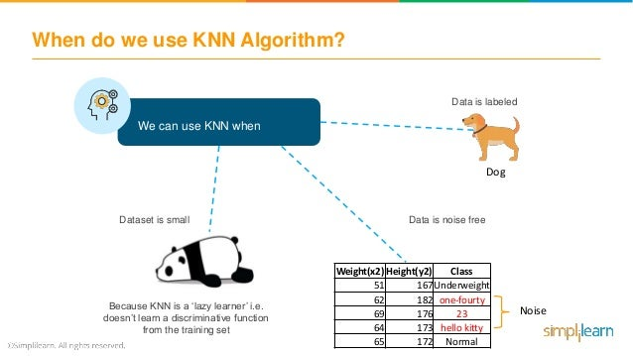
Data is labeled
Dataset is small
Data is noise Free
Because KNN is a “lazy learner” i.e doesn’t learn a discriminative function from the training set.
Noise

Slide 5
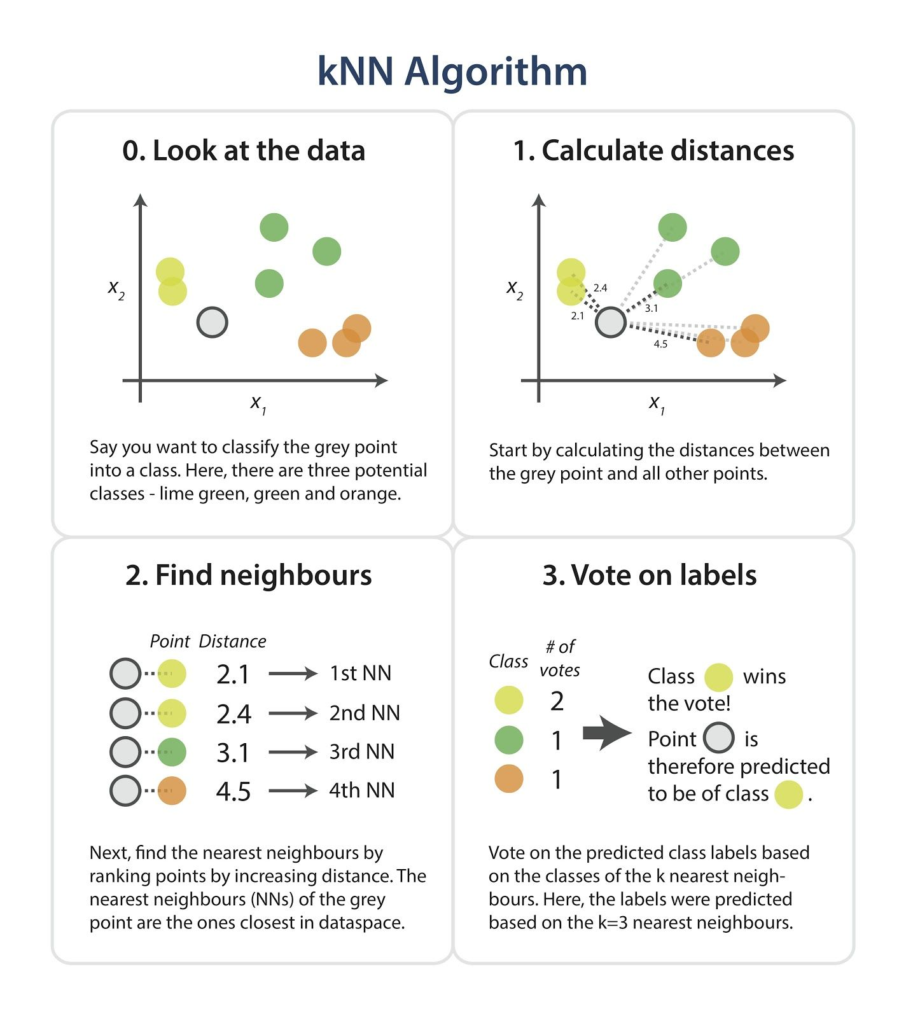

Slide 6
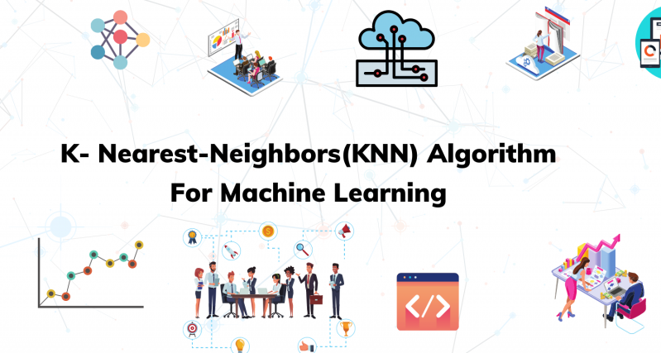


Slide 7
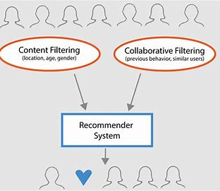
Real-World Application: Movie Recommendation System
Concept of KNN Algorithm:
In a movie recommendation system, KNN can be applied as follows:
Data Collection
Feature Representation
Recommendation Process
Distance Calculation
Nearest Neighbors
Recommendation

Slide 8
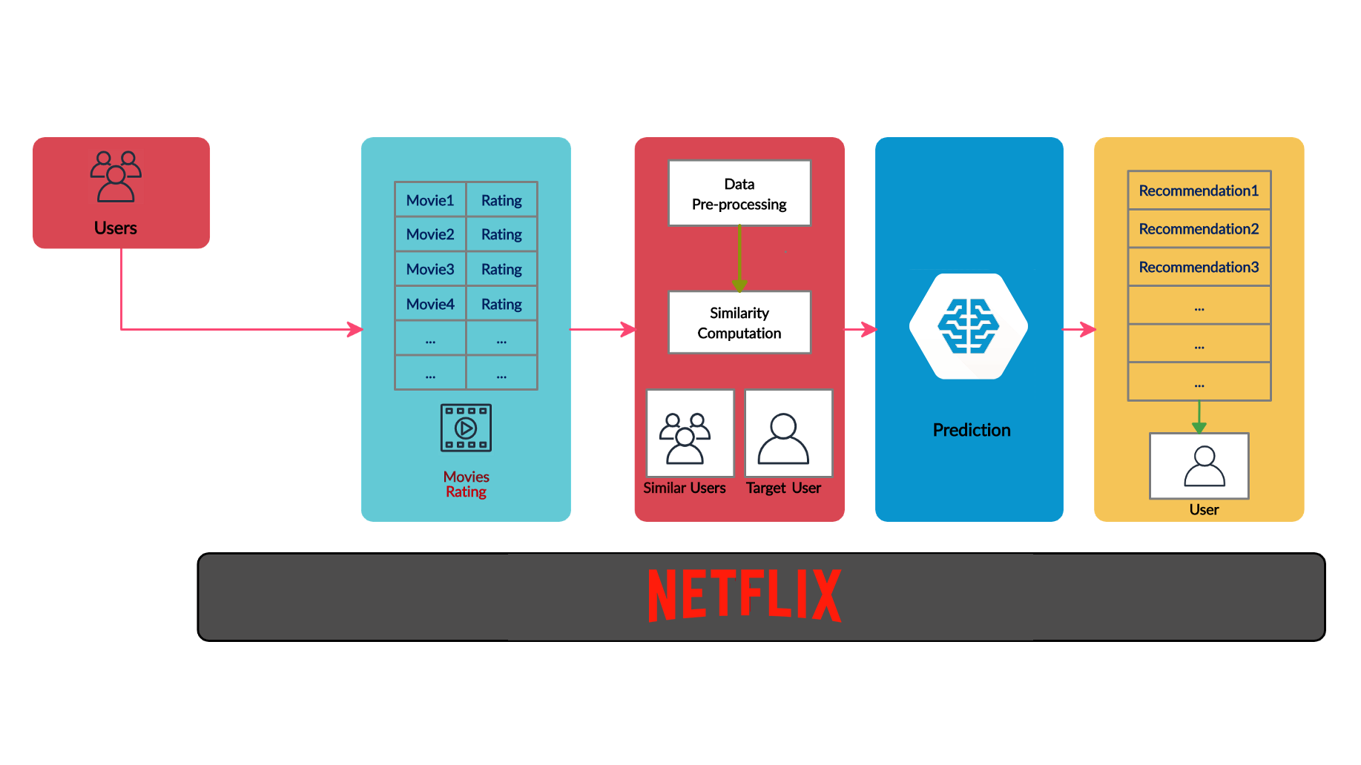

Slide 9
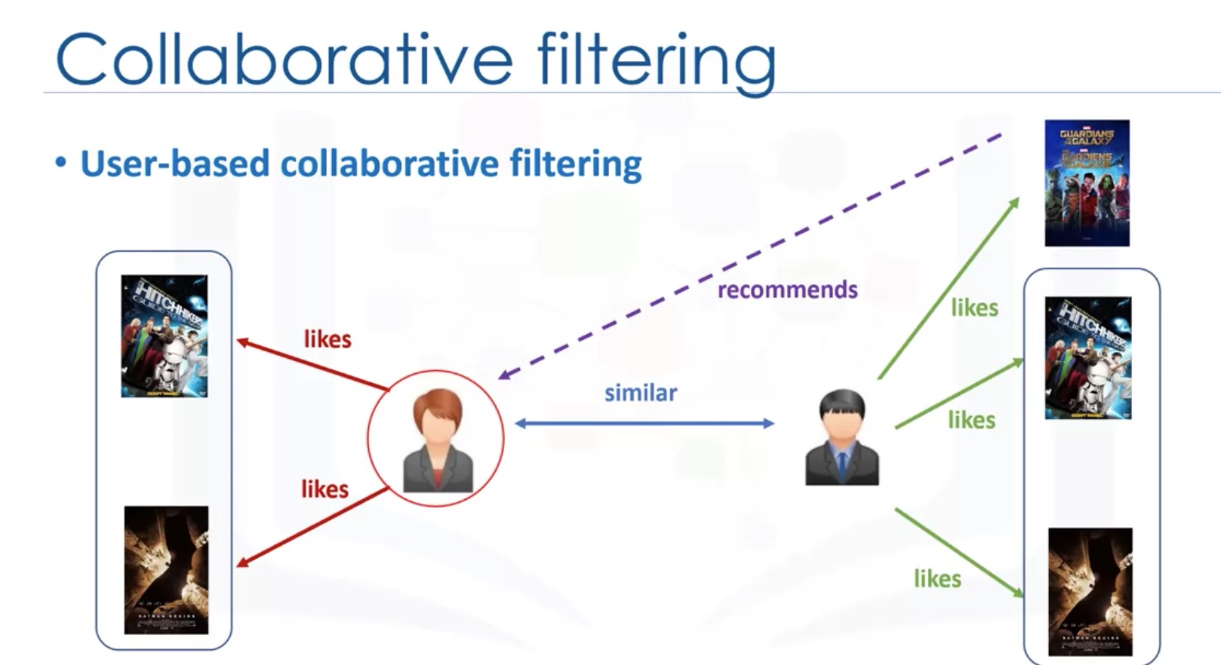

Slide 10
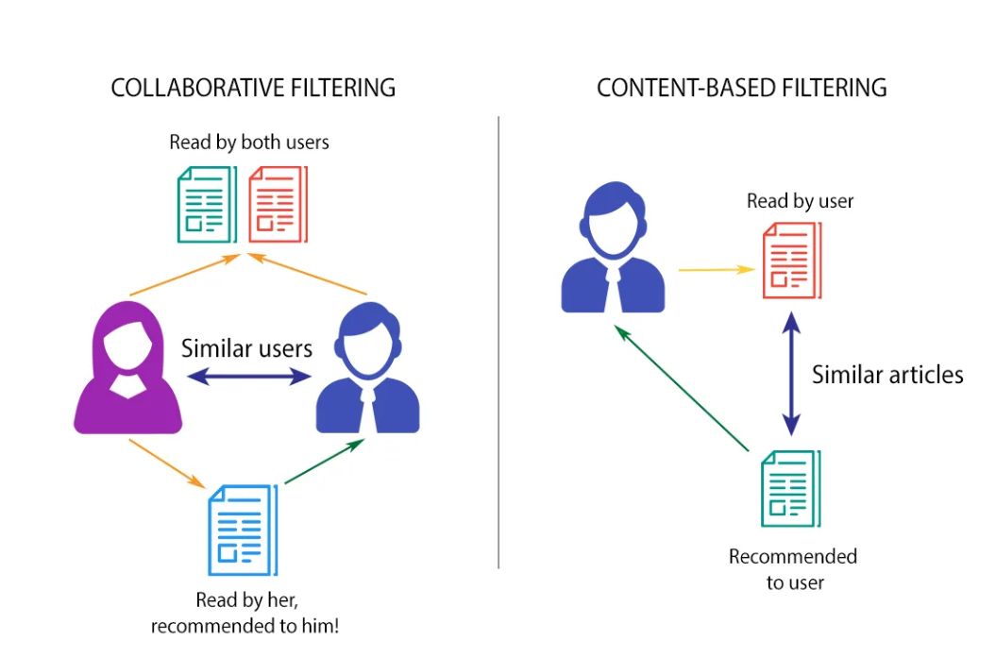
Use only two files from MovieLens datasets: ratings.csv and movies.csv

Slide 11
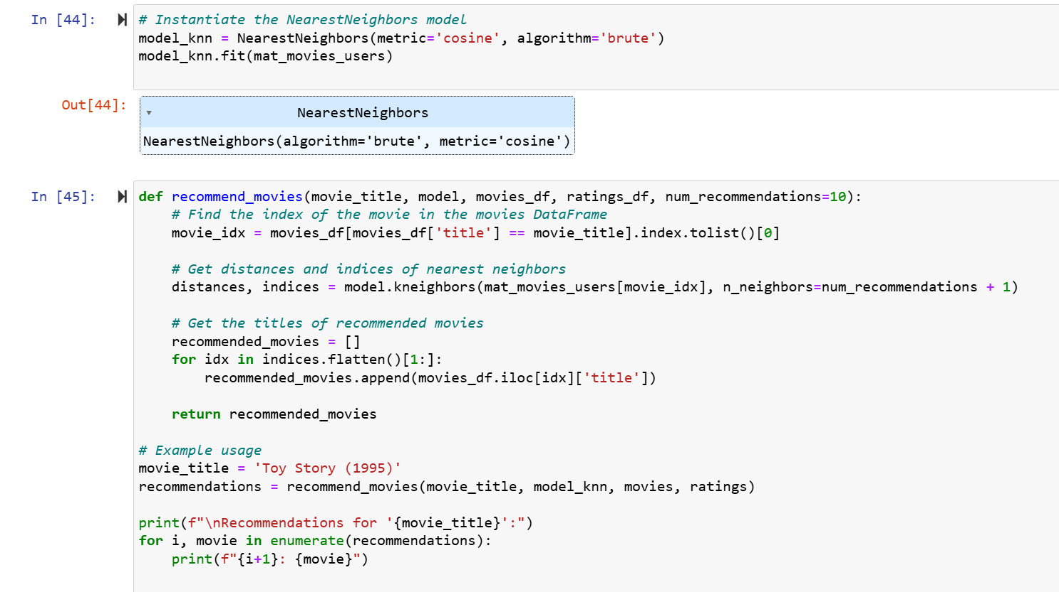
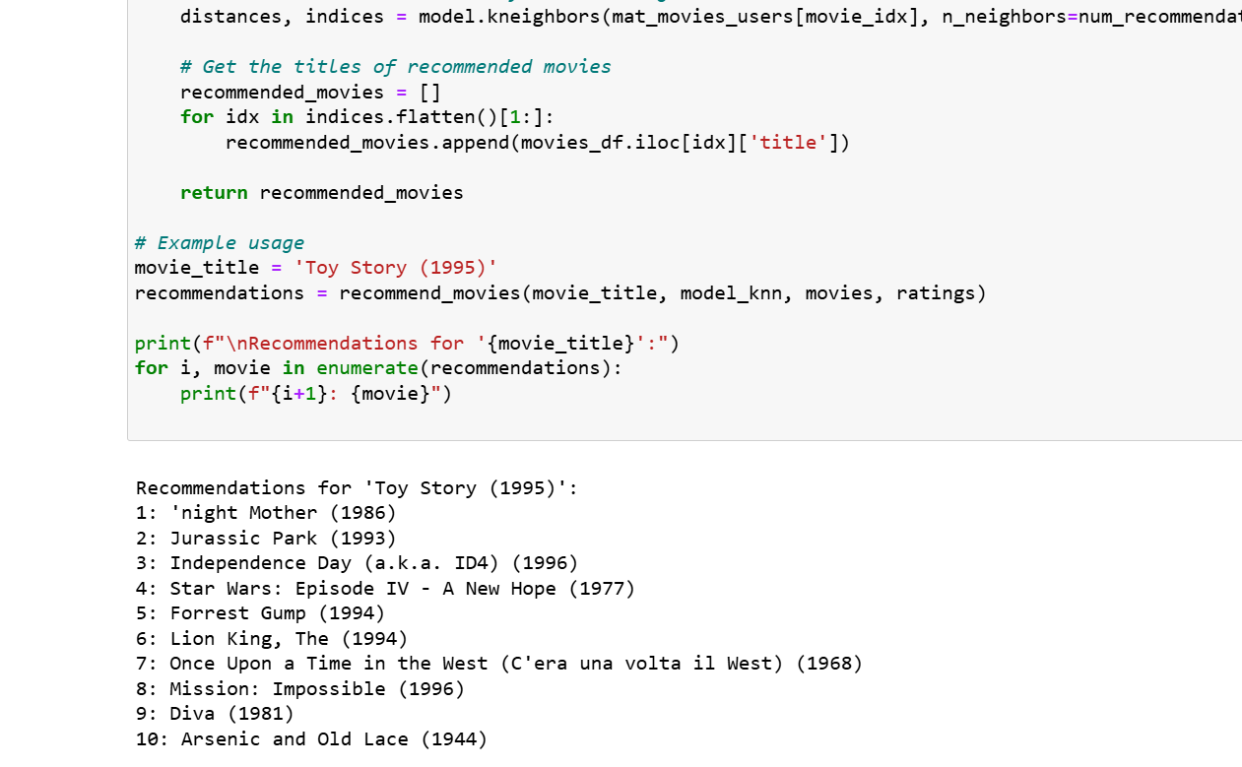
User Profile:
Suppose a user has watched and highly rated the following movies:
From these movies, we infer the user's preferences:
Genres: Action, Sci-Fi
Director preference: Christopher Nolan

Slide 12
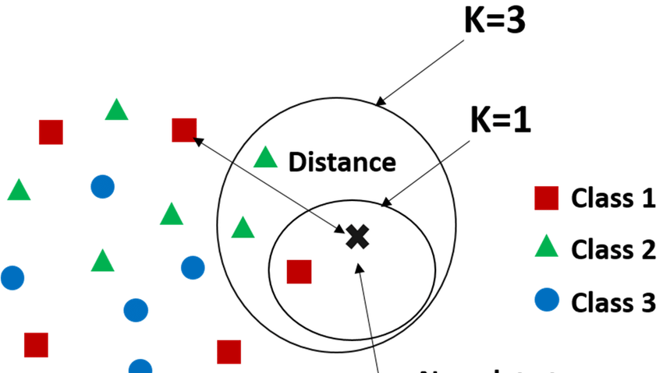
MODELLING

Slide 13
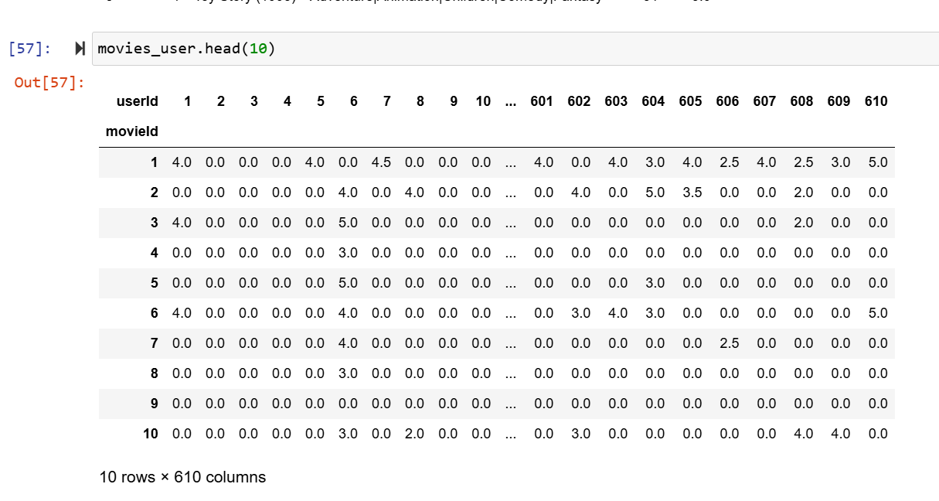
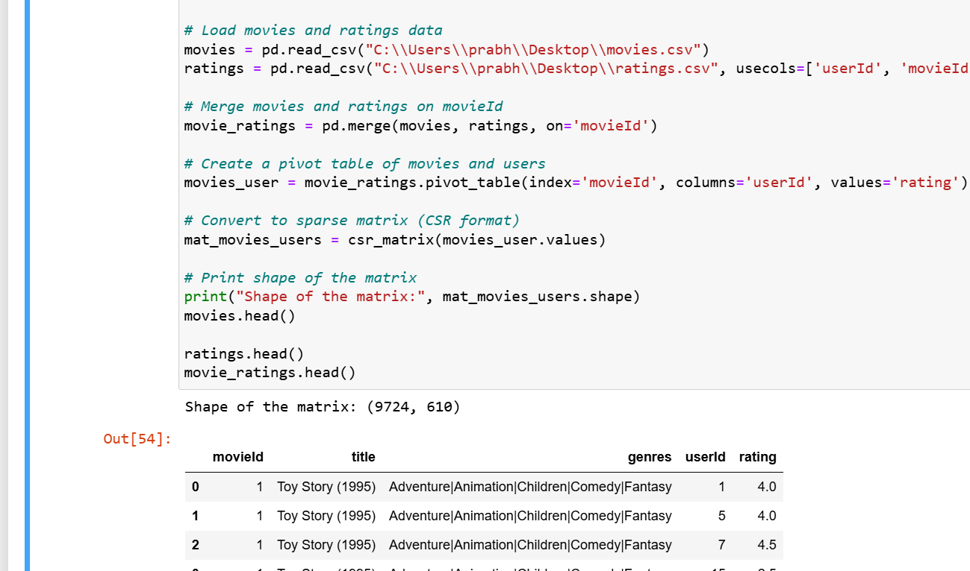
Feature Vectors:
Movies in the dataset are characterized by feature vectors that include:
Genre tags (e.g., action, sci-fi),Director (e.g., Christopher Nolan)
Other metadata that might be relevant (e.g., release year, actors)

Slide 14
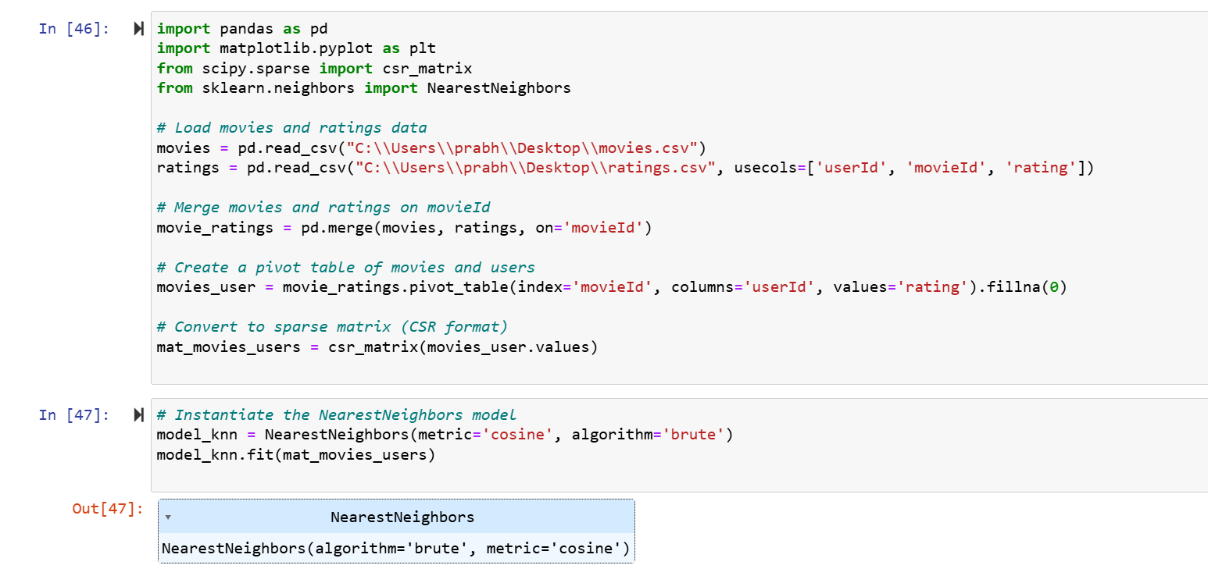
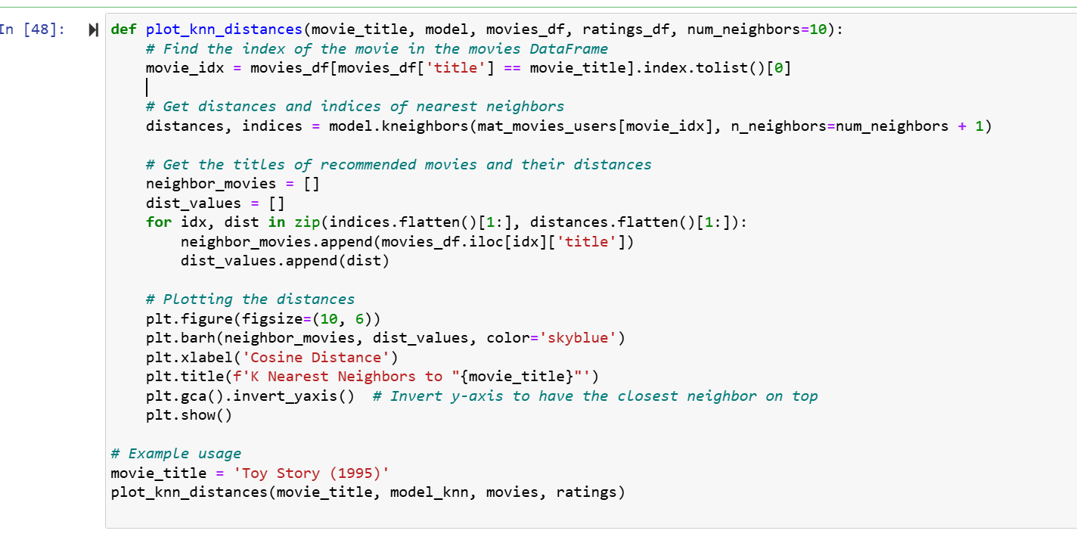
Recommendation Example Using KNN:
Building the Feature Space:
Calculating Similarity:
Finding Neighbors:
Generating Recommendations:
Presenting Recommendations:

Slide 15
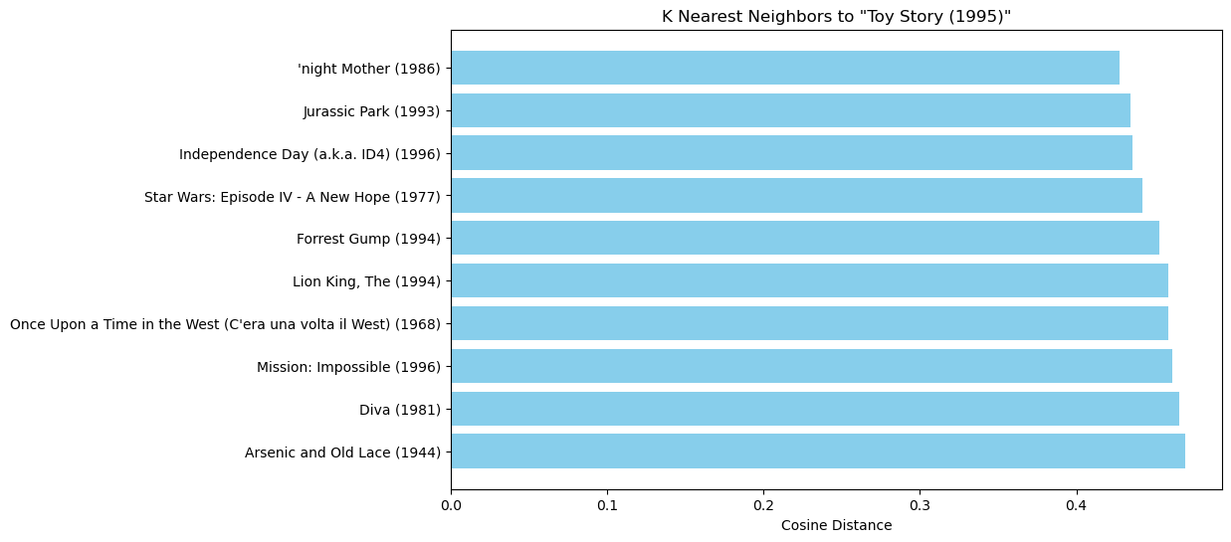

Slide 16
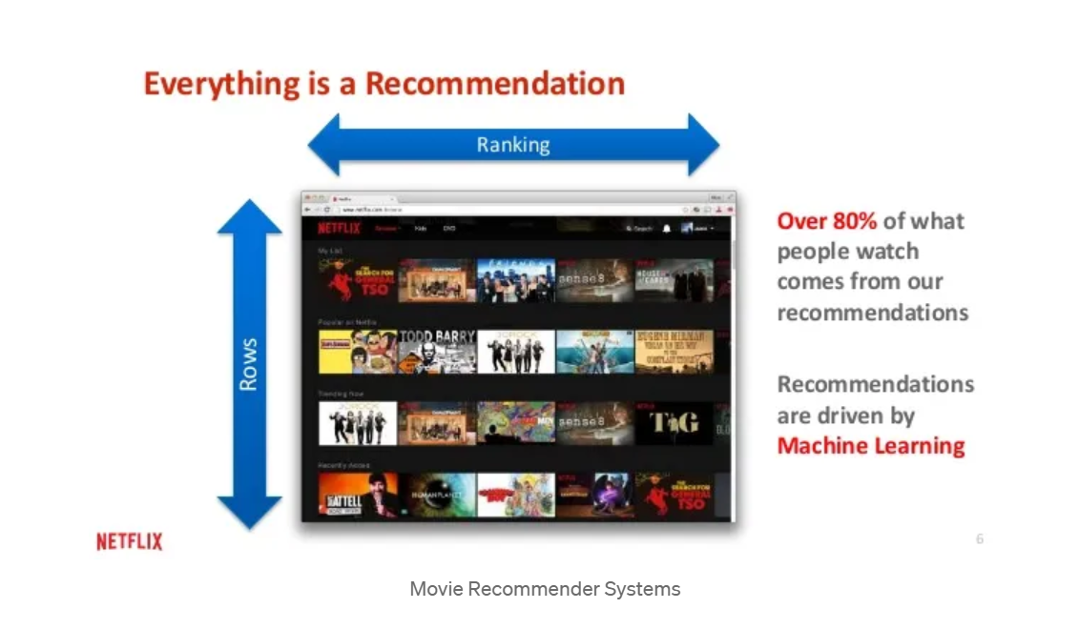
Conclusion: In this way, KNN leverages the feature similarities between movies to make recommendations. By understanding the user's preferences (action, sci-fi, Christopher Nolan), it identifies movies with similar features in the dataset and suggests those as recommendations. This method is effective for recommending niche preferences (like specific directors or genres) where users have clear preferences based on past viewing behavior.

Slide 17
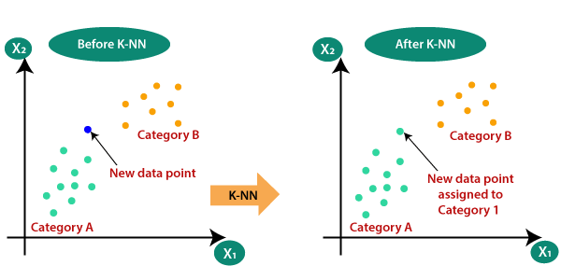

Slide 18
References
Submitted by:
Prabhjot Kaur :0858795
Pravjyot Kaur : 0857618
Surbhi Mehta : 0853144
Tamanna : 0857860
Manjeet Kaur : 0845752
Tanmay Gera : 0812523
Vishal Bagga : 0862360 Manav Kapatia : 0855050
Lovish : 0860189
Bhardwaj
Jatin Kashyap : 0857255
Using Collaborative Filtering in E-Commerce: Advantages & Disadvantage (clerk.io)
KNN | PPT (slideshare.net)
Tutorial 5 : K-Nearest Neighbor Algorithm (KNN) (youtube.com)
Applications of knn algorithm on real world example on movies recommendation system - Search Images (bing.com)
movie recommendation system using knn algoithm ppt presentation - Search (bing.com)
kNN Recommender System for Movie Recommendation (analyticsvidhya.com)
Prototyping a Recommender System Step by Step Part 1: KNN Item-Based Collaborative Filtering | by Kevin Liao | Towards Data Science
Building a Movie Recommendation System with Machine Learning (analyticsvidhya.com)

